Slide 1

IoT Based Smart Restaurant Menu Using BBB Wireless
Task_2: Developing GUI For Touch Screen
Submitted by:
Komal Preet Kaur
Group 3
Submitted to:
Prof. Mike Aleshams

Slide 2
Table of contents:
Introduction to project
Why GUI is needed in project?
Graphical User Interface
Nextion Display
Nextion Editor
Making GUI
Transferring GUI to Touch screen
Output: Testing of Touch screen with GUI
Conclusion
References

Slide 3
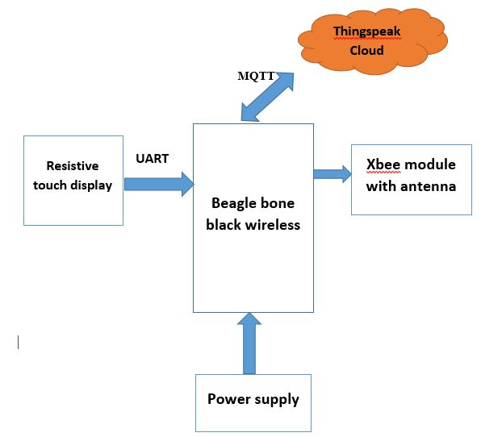
Introduction to Project:
Our project is IoT based smart restaurant food ordering menu using BBB-WI.
In our proposed project, we are using Nextion touch display which will be placed at each table of restaurant.
Using this display, a Food Ordering Menu is provided to customer.
Customer can place order for desired items and send order while sitting on the table without any involvement of waiter or hotel staff, which is main base of our project due to Covid-19 situation.

Slide 4
Why GUI is needed in our project?
GUI is Graphical User Interface, which is displayed on touch display and it is basic input device for our project.
It is an interface between user and touch screen , through which end user can interact with display.
Customer place their order by just touching buttons of some desired items and without going into the complexity of back-end programming and coding.
Graphical User interface is very simple and easy to understand interface and can be used by customer of every age.

Slide 5
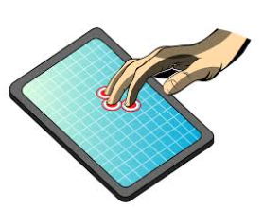
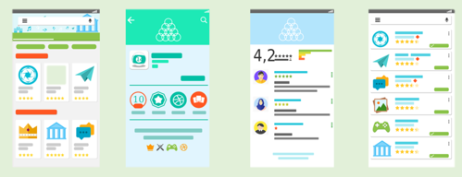

User interface:
The user interface (UI) is the point of human-computer interaction and communication in a device. This can include display screens, keyboards a mouse and the appearance of a desktop.
It is also the way through which a user interacts with an application or a website.
It determines how commands are given to the computer or the program and how information is displayed on the screen.

Slide 6
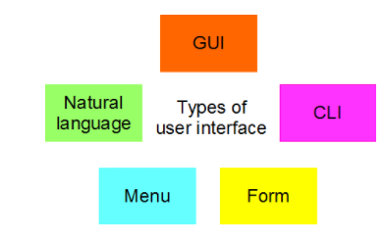
Types of User interface:
There are five different types of interface
Graphical User Interfaces (GUI)
Command Line Interfaces (CLI)
Form-based interfaces
Menu-based interfaces
Natural language interfaces.

Slide 7
Types of User interface : cond..
Graphical User Interfaces (GUI):
Interfaces that are graphical in nature are known either as Graphical User Interfaces (GUI) or WIMP interfaces (Windows, Icons, Menus and Pointer).
Typically, these types of interfaces are available in multi-tasking environments or in applications software that involve a considerable degree of complexity.
Command Line Interfaces (CLI):
A command line interface requires a user to type in commands from a list of allowable commands
For example, Terminal application in Ubuntu is a CLI

Slide 8
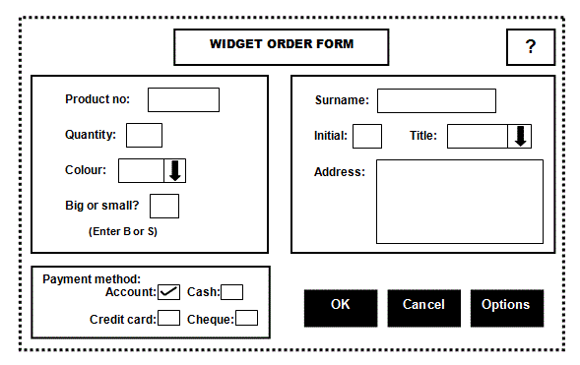
Types of User interface : cond..
Form-based interfaces:
A form-based software interface on a computer is similar to a paper-based 'interface'.
The input into the computer is predictable.
There are instructions to help, boxes where user write or select information from some choices and boxes where simply tick one of a selection

Slide 9
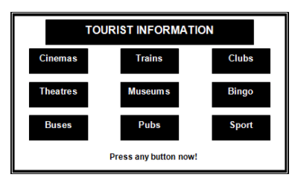
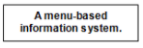
Types of User interface : cond..
Menu-based user interfaces:
Menu-based user interfaces are ideal for situations which require selections to be made from a very wide range of options or in situations which require very fast selection.
The user of a system that uses a menu-based interface will be presented with a limited number of options on the screen.
Once a selection has been made, the user is presented with a sub-menu.

Slide 10
Types of User interface : cond..
Natural Language interface:
This kind of interface requires the user to enter responses to questions asked by the computer.
The questions are displayed on the VDU and the answers are entered via the keyboard. This kind of interface is called a 'natural language' interface because the computer and the user appear to be holding a conversation.
For example, imagine the user has initiated a 'save file' request. The 'conversation' might go like this:
USER: Save file COMP: What is the file name? USER: chapter1.txt COMP: What folder? USER: User Guide COMP: File already exists. Overwrite? USER: Yes COMP: Done.

Slide 11
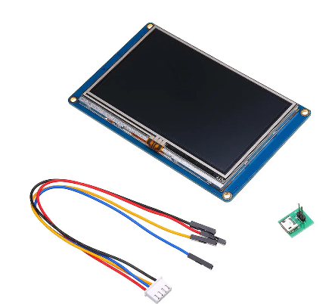
UI and touch display used in our project:
As our project contains the graphical and pictorial information, so I have developed a UI which is combination of GUI and menu based interface on touch display.
We chose Nextion display to use in our project because it comes with Nextion Editor to develop GUIs.
It is easy to develop GUI using Nextion Editor as instruction set and other information needed to develop GUI such as tutorials and examples are available on Official site of Nextion.

Slide 12
4.3’’ LCD Touch Display (Nextion):
Nextion is mainly applied to IoT or consumer electronics field. It is the best solution to replace the traditional LCD and LED Nixie tube. With the Nextion Editor software ,users are able to create and design their own interfaces for Nextion display.
The Nextion has a built-in ARM microcontroller that controls the display, for example it takes care of generating the buttons, creating text, store images or change the background.
The Nextion communicates with any microcontroller using serial communication at a 9600 baud rate.

Slide 13
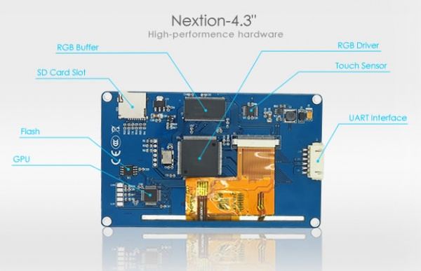
Basic elements of LCD touch screen

Slide 14
Specifications of touch display:
Compatible with Raspberry Pi, Arduino and other MCUs.
480 x 272 resolution
RGB 65K real life colors
TFT monitor with integrated 4-wire resistive touch panel
Easy 4 pin interface to any TTL serial host
16M Flash memory for user application code and data
On board micro-SD card for firmware update
Viewing Area: 95.04mm (L) × 53.86mm (W)
Adjustable brightness: 0 ~ 230 nit, the adjustment interval is 1%
5V250mA power consumption
Has a built-in RTC
supports GPIOs

Slide 15
Nextion editor: making gui
The GUI design and layout is done in a development environment (IDE) provided by ITead Studio.
Once installed opening the IDE presents the user with a clean and well organized user interface.
The IDE is organized into 8 sections as shown in the image in next slide, each section has a unique task to perform or information to convey.

Slide 16
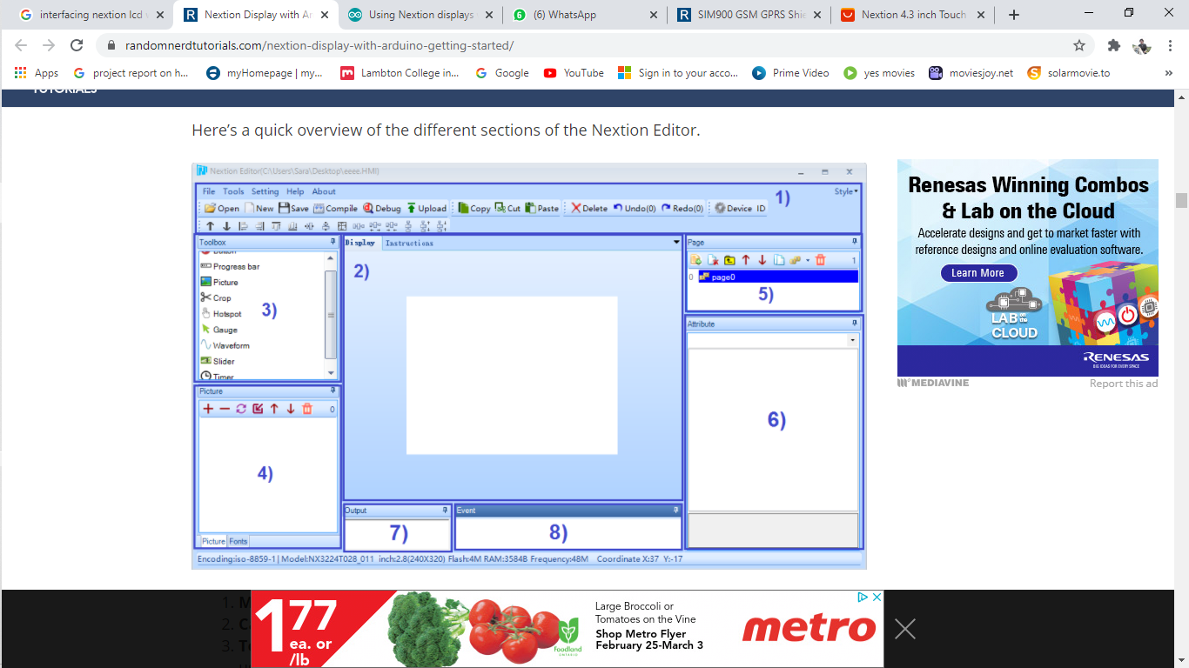
Nextion Editor IDE:

Slide 17
Nextion Editor IDE:
Main Menu : Menus including save, open, etc. are found here.
Canvas –Working area, this is where the graphical display is designed and shown. It is in this area a scale representation of the display is shown as a canvas on which to work. All desired components are added and arranged with in this area to represent how the final display should look
Toolbox – this is where we have a wide variety of components we can add to the user interface, like pictures, progress bar, buttons, sliders, and much more.
Picture/Fonts list – this shows the fonts and pictures imported to our projects. Here we can also add new fonts and pictures.
Page area – we can manage our pages here, like add more pages, copy and delete pages.
Attributes area – this part shows our component’s attributes. We can edit the component’s attributes here.
Compiler output window – this will show any errors occurred during compiling.
Event window – here we can add code to be run when an event is met.

Slide 18
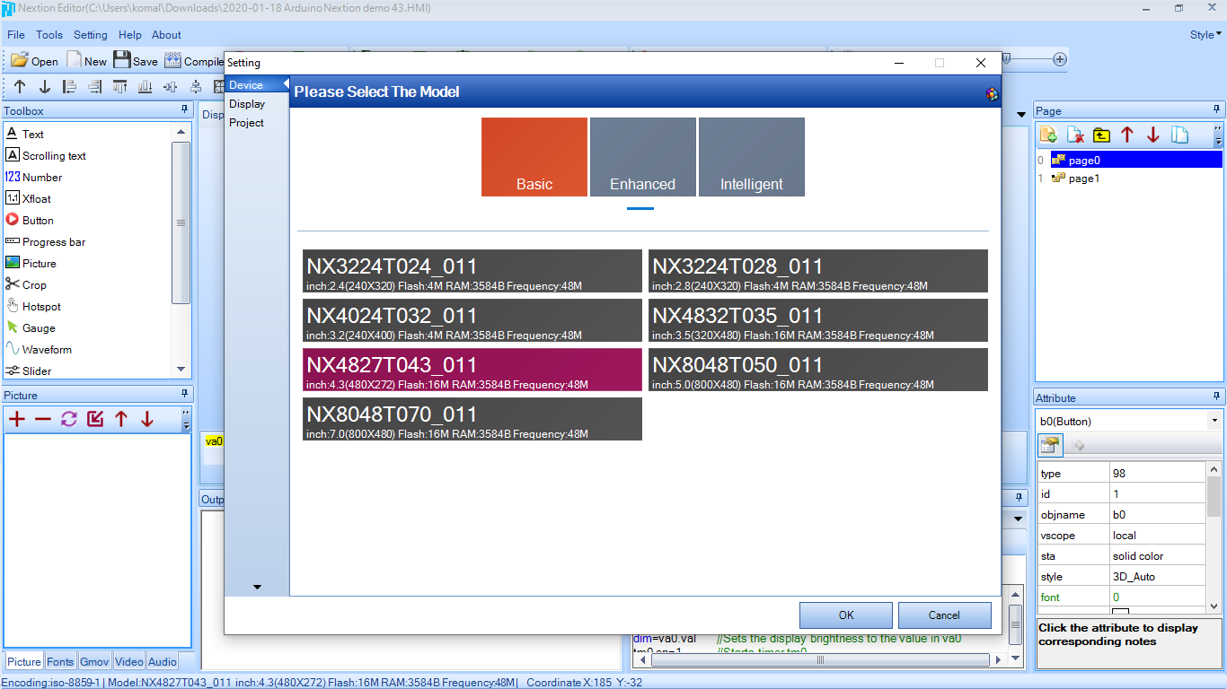
Making GUI:
Clicked on new project and selected my device and selected display model.

Slide 19
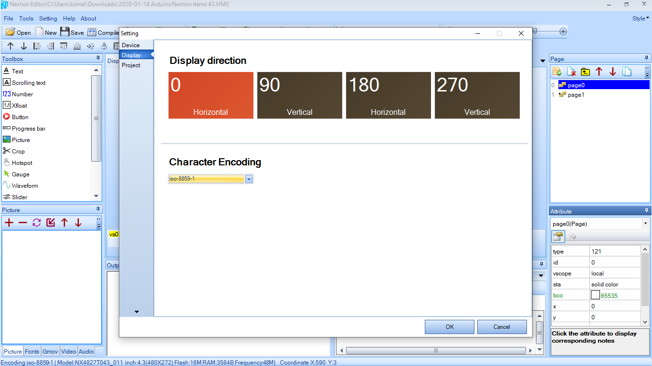
Making GUI:
Now we will select display direction according to our requirement.
Here, we have selected horizontal 0.

Slide 20
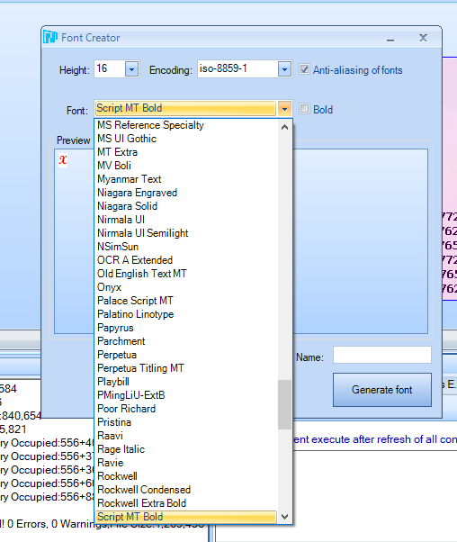
Importing pictures and fonts to ide:
In order to use pictures and fonts in GUI, first we need to import these.
To import fonts, we need to Open tools from menu bar, and then select fonts from font generator.
We need to select font size prior to inserting text according to our requirement and we cannot change it afterwards.
To import pictures, we need to download any image of our choice and resize it according to our requirement.
For our display , we used 480 * 272 resolution image, because it fits the display properly.

Slide 21
Instructions used in programming
page0.z0.val=page0.z0.val+1”.
Page0 refers to the screen number the component is part of.
Z0 is the name of the component
Val is the value of the specific component
“n0.val=z0.val”.
This simple line updates the number displayed on the screen.
Page <id>
This instruction change page number to specified page.
covx h0.val,t0.txt,0,0 //
convert value of h0 into t0.txt without leading zeros
print t0.txt
return 1 byte per char of t0.txt without null byte ending.

Slide 22
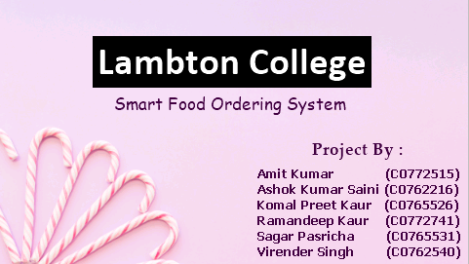
Main page of display:
This is the first page of GUI. Nextion display loads page 0 by default on power ON
In this page, I have inserted a background image of same resolution as that of touch display.
I have added three text boxes as per my requirement and it is clear in this picture.
Most important thing here is customer need to touch anywhere on this main page to enter into main menu. So, I have created a touch release event which will connect it to page 2(menu page).
page 1 //this instruction will change page to the specified page(Here page 1)

Slide 23
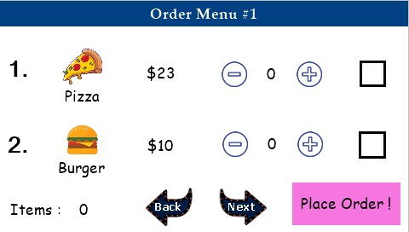
Order menu 1:
This is first page of the main menu, In which I have added two items pizza and burger.
Firstly, I have imported images for pizza and burger and I have selected the resolution for these pictures as 70*70.
Next to images I have added another text box for price and the check box to select the item.

Slide 24
Order menu 1:
In this code, if value of c0=0 ,it means user has not selected that item. Then, user can not increase the quantity of that item.
If item is selected using check box only then user can increase the quantity.
item_1.txt+="|23“
item_1.txt+="|PZA"}
Using these instructions information about the order is transferred to txt file.
Same code is used for check boxes associated with all the items, only the information transferred to text file is changed.
I have added one touch release event with check box whose code is given below
if(c0.val==0)
{ n0.val=0
counter.val-=1
item_1.txt=""}
Else
{
counter.val+=1
n0.val=1
item_1.txt=""
covx n0.val,item_1.txt,0,0
item_1.txt+="|23“
item_1.txt+="|PZA"}
itemn.val=counter.val

Slide 25
Order menu 1:
Code ( touch release event ) associated with decrement(-) button
if(c0.val==1)
{
if(n0.val>1)
{
n0.val-=1
item_1.txt=""
covx n0.val,item_1.txt,0,0 item_1.txt+="|23" item_1.txt+="|PZA" }}
In this code, if an item is selected using check box, then following code is use to decrease the number of items
n0.val-=1
The following instruction concatenate left side with right side and place result in left side. Using this instruction we are passing the quantity of ordered item into text file.
item_1.txt+="|23" item_1.txt+="|PZA" }}

Slide 26
Order menu 1:
Touch release event associated with increment event.
if(c0.val==1)
{
n0.val+=1
item_1.txt=""
covx n0.val,item_1.txt,0,0
item_1.txt+="|23"
item_1.txt+="|PZA"}
Else
{
covx n0.val,item_1.txt,0,0 item_1.txt+="|23“
item_1.txt+="|PZA"}
In this code, if an item is selected using check box, then following code is used to increase the number of items
n0.val+=1
The following instruction concatenate left side with right side and place result in left side. Using this instruction we are passing the quantity of ordered item into text file.
item_1.txt+="|23" item_1.txt+="|PZA" }}
The following instruction is used to convert variable from numeric type value n0 into item_1.text

Slide 27
Order menu 1:
Touch release event associated with back button.
page 0 //this instruction will change page to the specified page(Here page 0)
Touch release event associated with next button
page 2
page3.con.txt="“ //This instruction will append the page number.

Slide 28
Order menu 1:
This code uses several if statements to produce main order.
The following command will send raw formatted data over serial to MCU and change page no to page 3
print page3.con.txt
page 3
Touch release event associated with place order button .
if(itemn.val>0)
{ page3.con.txt="“
if(item_1.txt!="")
{ page3.con.txt+="="+item_1.txt }
if(item_2.txt!="")
{ page3.con.txt+="="+item_2.txt }
if(page1.item_3.txt!="")
{ page3.con.txt+="="+page1.item_3.txt }
if(page1.item_4.txt!="")
{ page3.con.txt+="="+page1.item_4.txt }
print page3.con.txt
page 3}

Slide 29
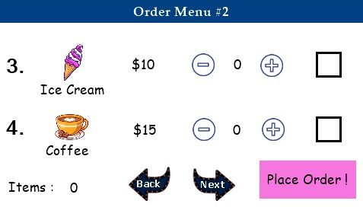
Order menu 2:
All the elements and touch release event are similar to order menu 1 except from name and prices.
In this page, I have added two more items ice cream and Coffee, with their respective prices.
Place order button will link this page to next page which is about confirmation of order.

Slide 30
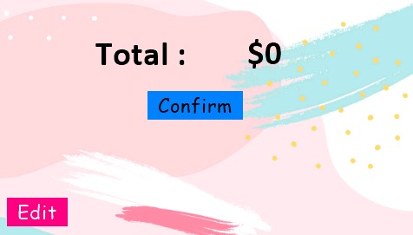
Page 3 :Confirm order?
In this page, we have added two text boxes, one for string Total: and other for numeric value to show the total amount.
Confirm button will lead to next page.
Edit button is linked to main menu, if customer want to make any changes in order.

Slide 31
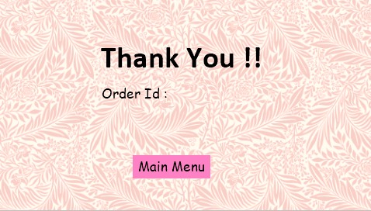
Page 4 :order id
This is the last page in which “Thank you!!” message will displayed on screen.
An order Id will be generated from the MCU side and displayed on the screen.
Main menu button has touch release event linked to page 1.

Slide 32
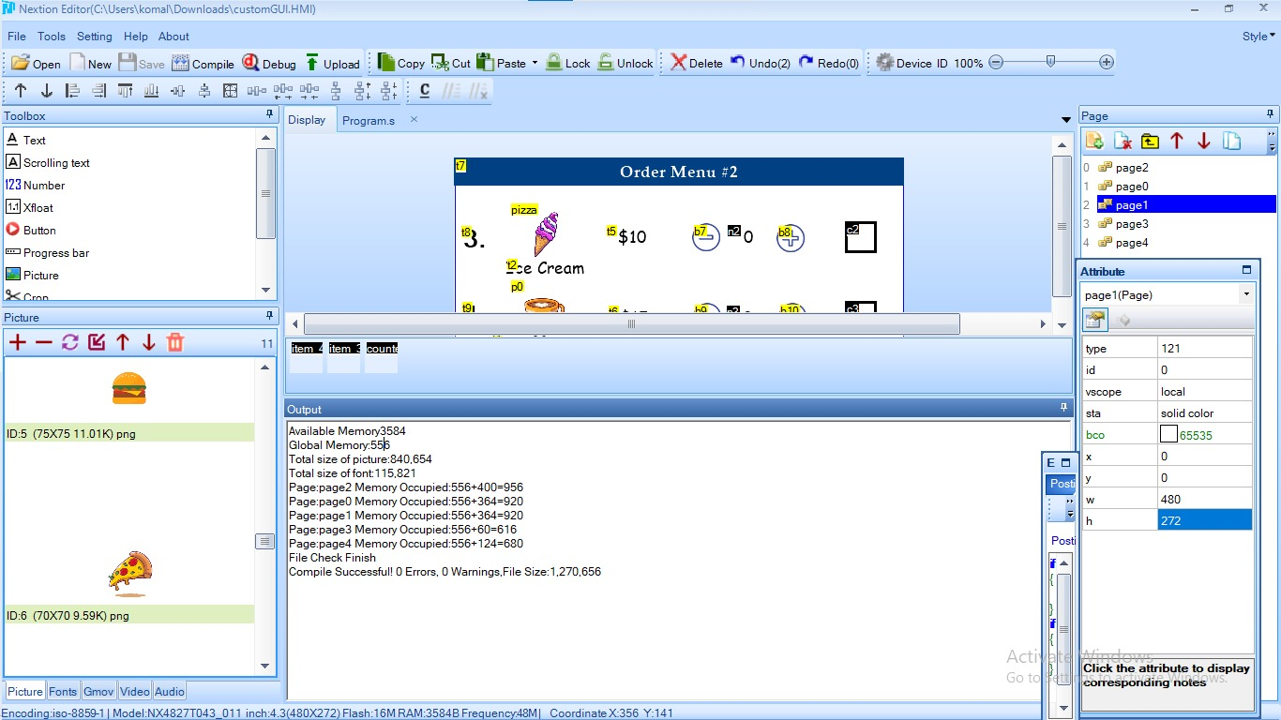
compiling code to display
Click the Compile button in the main menu;

Slide 33
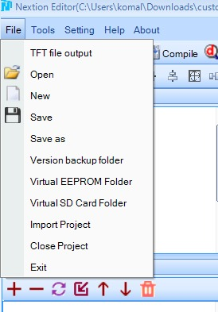
uploading code to display
Insert the microSD card on your computer;
Go to File > Open Build Folder ; Copy the .TFT file corresponding to the file you’re currently working;
Paste that file in the microSD card Insert the microSD card on the Nextion display and plug power.

Slide 34
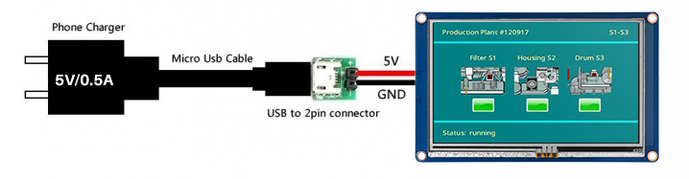
Connecting display to power supply
We can directly connect it to supply using a micro USB adaptor(5V/0.5A).
A USB to 2-pin connector is used between adaptor and touch display.
After connecting display will lights up.

Slide 35
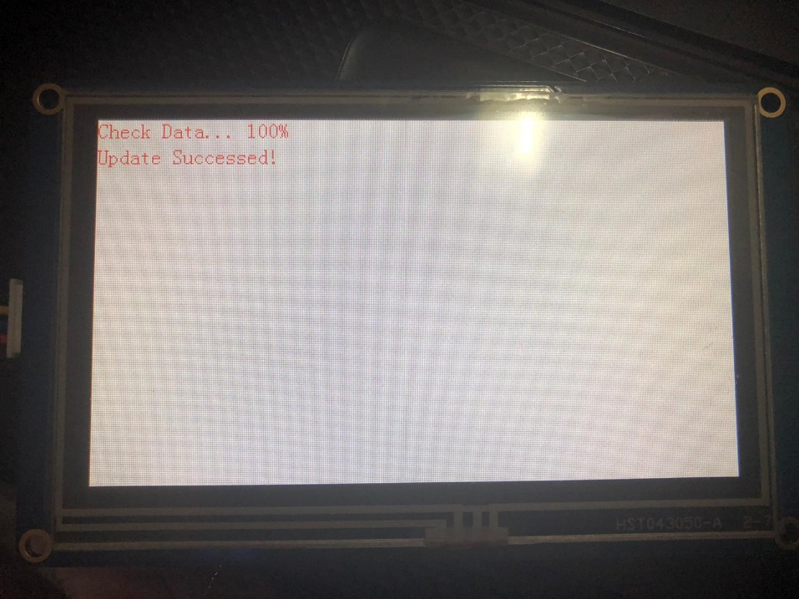
uploading code to display : cond…
The Nextion will go into a bootloader mode and will display the file size and the progress. This takes a few moments, once completed a message “Update Successful!” will be displayed on the display.
Power down the display, remove the microSD card and power up the display again. This time the GUI we have selected will be running on the display.

Slide 36
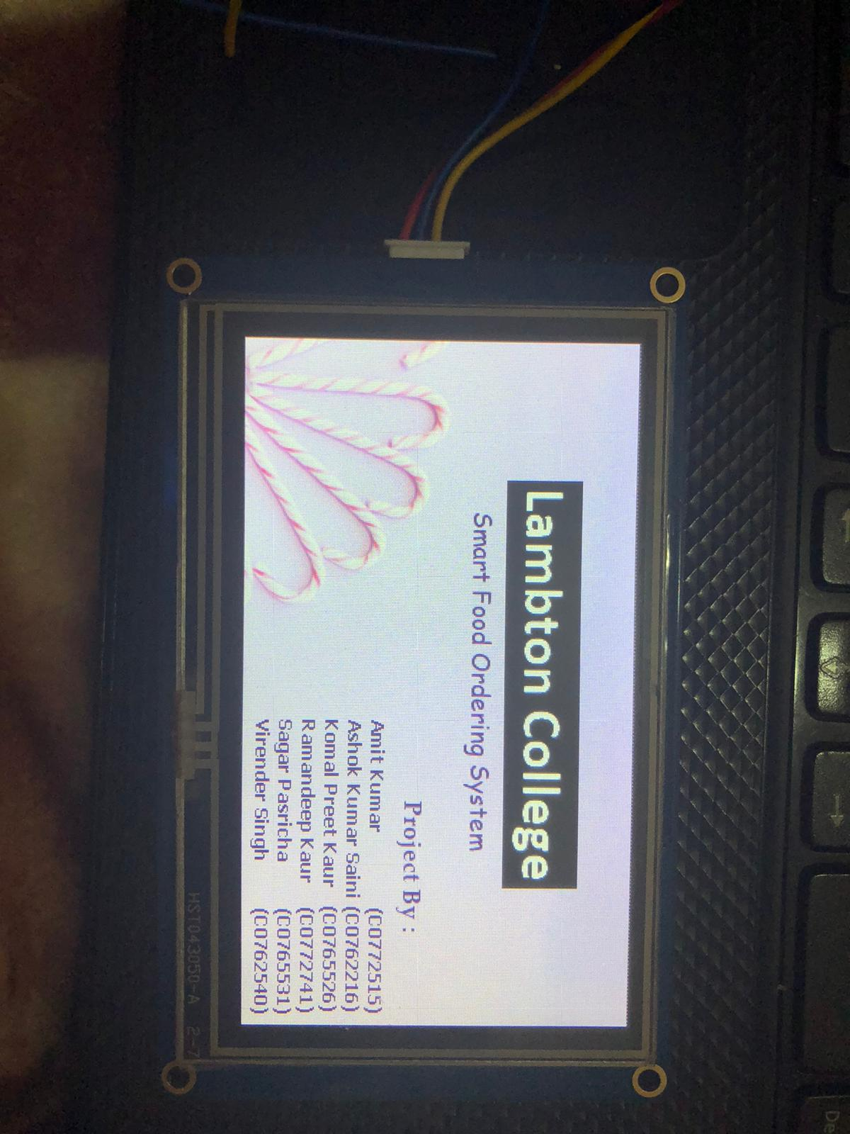
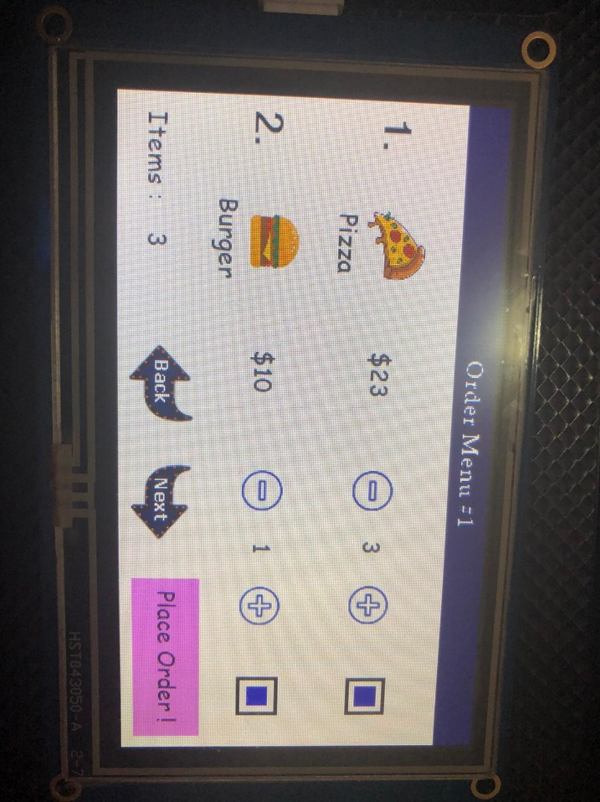
Output: Testing of Touch screen with GUI
Main screen
Menu Page

Slide 37
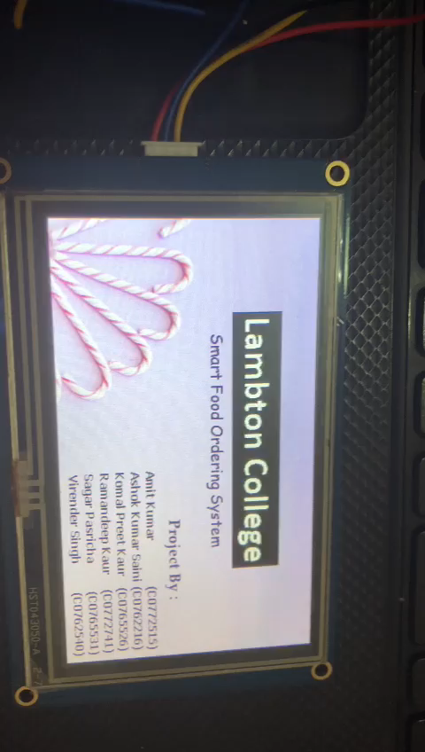
Output Video: GUI

Slide 38
Conclusion:
In conclusion, Nextion IDE is easy to use but some instructions are difficult to understand and need some practice to use.
The ability to have the display do most of the onboard control or even be self contained is both handy and useful .
GUI can be reviewed before uploading to touch screen itself.
So, development of GUI task is successfully completed.

Slide 39
References:
User Interface:
https://searchapparchitecture.techtarget.com/definition/user-interface-UI#:~:text=The%20user%20interface%20(UI)%20is,an%20application%20or%20a%20website.
https://www.slideshare.net/AbdulGrails/user-interface-43112351
Types of user interface:
http://theteacher.info/index.php/systems-software/notes/4623-types-of-user-interface
Creating GUI:
https://www.element14.com/community/community/arduino/blog/2016/02/22/nextion-hmi-display-a-user-interface-that-is-simple-and-easy-to-use
https://www.youtube.com/watch?v=qx-aFB3-7SA

Slide 40
References:
https://www.itead.cc/blog/advanced-application-3-slide-to-unlock-and-battery-charging-progress-project
https://www.itead.cc/blog/an-entry-application-of-text-component-and-button-component
Instruction set:
https://nextion.tech/instruction-set/
Specifications of Nextion touch screen display:
https://nextion.tech/datasheets/nx4827t043/

